Slide 1
Computer Vision with Embedded Machine Learning
Object Detection Models

Slide 2
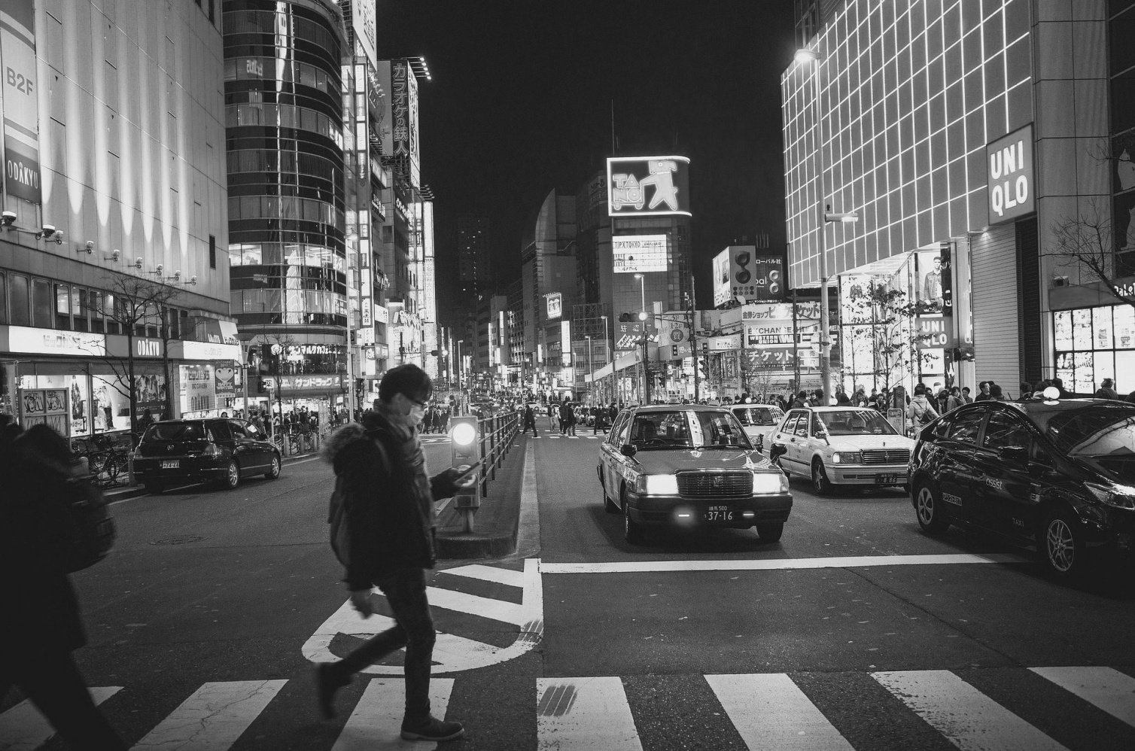
Region-based Convolutional Neural Network (R-CNN)

Slide 3
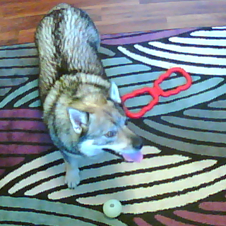
dog
toy
ball

Slide 4

person
package

Slide 5
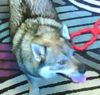



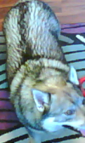

R-CNN
Class predictions:
background
ball
dog
toy
Region Proposal
CNN
SVM
Regressor
d_{x}, d_{y}, d_{w}, d_{h}

Slide 6
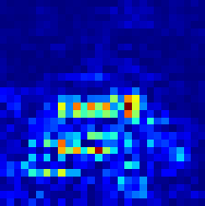
Fast R-CNN
Class predictions:
background
ball
dog
toy
CNN
ROI Pooling
FC Layers
Flatten
FC Layer
Region Proposal
Regressor
(FC Layer)
d_{x}, d_{y}, d_{w}, d_{h}

Slide 7
Faster R-CNN
CNN
Class predictions:
background
ball
dog
toy
e.g. VGG19, MobileNet
ROI Pooling
FC Layers
Flatten
FC Layer
Region Proposal
Network
Regressor
(FC Layer)
d_{x}, d_{y}, d_{w}, d_{h}

Slide 8
Single Shot MultiBox Detector (SSD)
Conv.
CNN backbone
Conv.
Conv.
Conv.
Conv.
Conv.
Non-Maximum Suppression (NMS)
Conv.
Conv.
Conv.
Conv.
Conv.
Conv.
e.g. VGG19, MobileNet
Class predictions + boundary boxes

Slide 9
Single Shot MultiBox Detector (SSD)
Conv.
CNN backbone
Conv.
Conv.
Conv.
Conv.
Conv.
Non-Maximum Suppression (NMS)
Conv.
Conv.
Conv.
Conv.
Conv.
Conv.
e.g. VGG19, MobileNet
Class predictions + boundary boxes

Slide 10
Single Shot MultiBox Detector (SSD)
Conv.
CNN backbone
Conv.
Conv.
Conv.
Conv.
Conv.
Non-Maximum Suppression (NMS)
Conv.
Conv.
Conv.
Conv.
Conv.
Conv.
e.g. VGG19, MobileNet
Class predictions + boundary boxes

Slide 11
Single Shot MultiBox Detector (SSD)
Conv.
CNN backbone
Conv.
Conv.
Conv.
Conv.
Conv.
Non-Maximum Suppression (NMS)
Conv.
Conv.
Conv.
Conv.
Conv.
Conv.
e.g. VGG19, MobileNet
Class predictions + boundary boxes

Slide 12
Single Shot MultiBox Detector (SSD)
Conv.
CNN backbone
Conv.
Conv.
Conv.
Conv.
Conv.
Non-Maximum Suppression (NMS)
Conv.
Conv.
Conv.
Conv.
Conv.
Conv.
e.g. VGG19, MobileNet
Class predictions + boundary boxes

Slide 13
Single Shot MultiBox Detector (SSD)
Conv.
CNN backbone
Conv.
Conv.
Conv.
Conv.
Conv.
Non-Maximum Suppression (NMS)
Conv.
Conv.
Conv.
Conv.
Conv.
Conv.
e.g. VGG19, MobileNet
Class predictions + boundary boxes

Slide 14
Non-Maximum Suppression (NMS)
dog: 0.92
dog: 0.85
dog: 0.79

Slide 15
Non-Maximum Suppression (NMS)
dog: 0.92
dog: 0.85
dog: 0.79

Slide 16
Non-Maximum Suppression (NMS)
IoU: 0.77
IoU: 0.68

Slide 17
Non-Maximum Suppression (NMS)
dog: 0.92

Slide 18

person: 0.72
person: 0.99
car: 0.98
car: 0.83
car: 0.95
car: 0.87

Slide 19
dog
toy
ball

Slide 20
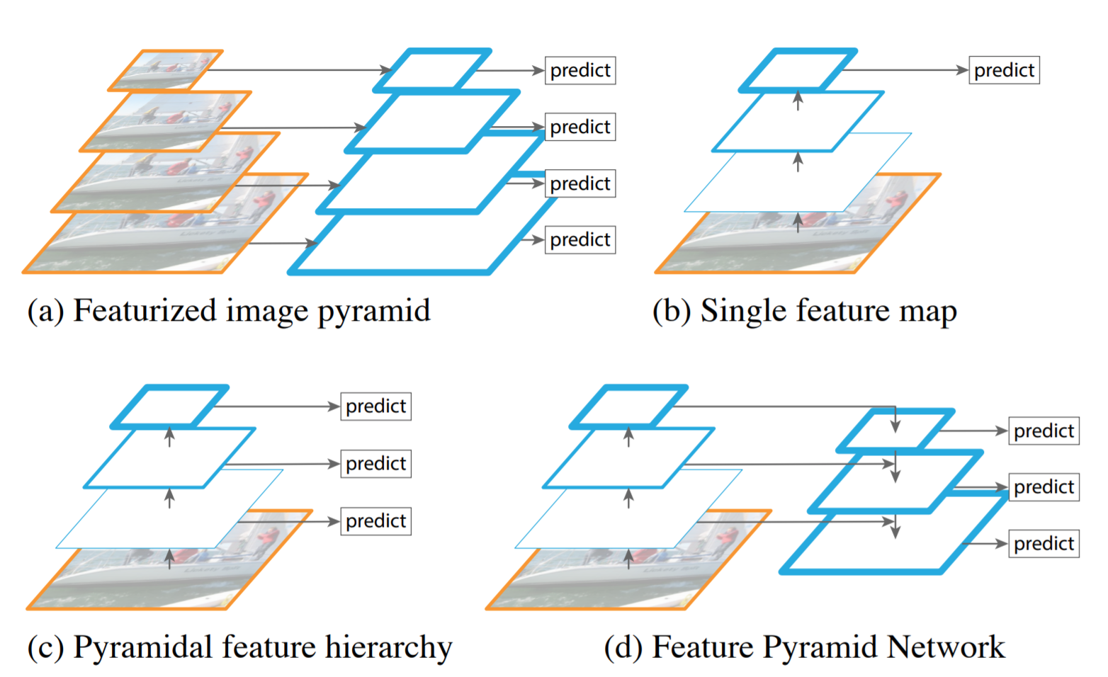
Feature Pyramid Network (FPN)
Image source: “Feature Pyramid Networks for Object Detection” (https://arxiv.org/pdf/1612.03144.pdf)

